Slide 1
Product Overview

Slide 2
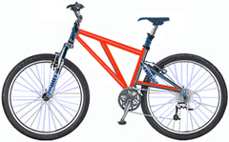
Product Overview
Mountain-200
Product No: BK-M68B-38
Size: 38
Weight: 25
Price: $2,294.99

Slide 3
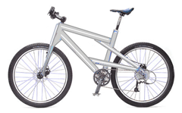
Product Overview
Mountain-300
Product No: BK-M47B-38
Size: 35
Weight: 22
Price: $1,079.99

Slide 4
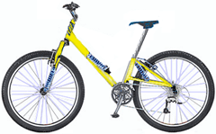
Product Overview
Road-150
Product No: BK-R93R-44
Size: 44
Weight: 14
Price: $3,578.27

